Slide 1
Activities Booking Platform
MID DEFENSE PRESENTATION BY
Santosh K.C.
Abhishek Thakur

Slide 2
Outline
Introduction
Objective
Problem Statement
Literature Review / Background Study
Methodology
Tools and Technology
Tasks Completed
Tasks Pending
Conclusion
Reference

Slide 3
Introduction
The Activities Booking Platform is a website that enables users to easily discover and reserve diverse recreational experiences in one place. In Nepal, abundant adventure sports, cultural workshops, and leisure activities are often difficult to access due to fragmented booking through agencies or phone calls. This project aims to build an integrated platform that offers a seamless, convenient experience for users and business for managing and booking those activities.

Slide 4
Problem Statement
Booking recreational activities in Nepal is fragmented and mostly offline.
Global platforms cover only limited activities and miss local experiences.
Users face difficulty in discovering, and reserving activities.
Businesses struggle with reaching customers and managing reservations.

Slide 5
Objective
Create a centralized platform to search, and book activities in Nepal.
Help businesses gain visibility and manage bookings online.
Ensure a user-friendly interface with trust through verified listings and reviews.
Provide a secure platform where the user data are secured

Slide 6
Literature Review/ Background Study
Buhalis and Law highlights how online tourism platforms have transformed booking processes globally by increasing convenience, transparency, and user trust through aggregated listings and reviews[1].Maswera, Dawson, and Edwards discusses e-commerce adoption challenges in African tourism markets, emphasizing the importance of localized features and digital strategies for improving visibility of regional businesses[2].
Based on the study we have found that online tourism platforms have significantly improved the global booking process by making it more convenient and transparent, while building user trust through reviews and aggregated listings. At the same time, the findings highlight that in developing tourism markets, particularly in Africa, successful adoption of these platforms depends heavily on localized digital strategies that address regional challenges and improve the visibility of local tourism businesses.

Slide 7
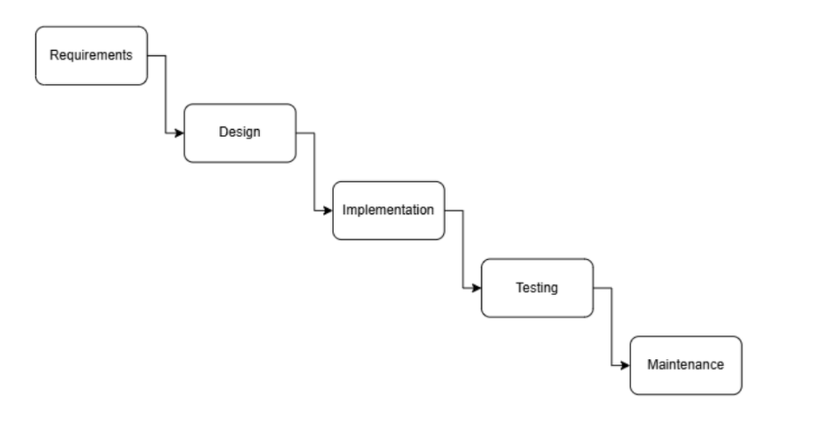
Methodology
Figure 1: Waterfall Methodology

Slide 8
Requirement Analysis
Functional Requirement
The system shall allow users to search, and book diverse recreational activities in Nepal.
The system shall enable service providers to list activities with details like type, cost, schedule, location, and safety guidelines.
Users shall be able to create and manage profiles with personal information and booking history.
The system shall provide secure authentication for both users and providers.

Slide 9
Requirement Analysis
The system shall allow administrators to monitor bookings, user activity, and service performance.
Users shall be able to give ratings and feedback for activities to improve service quality.

Slide 10
Requirement Analysis
Non-Functional Requirements
The system must be scalable to handle multiple users booking activities simultaneously without performance degradation.
The system must ensure secure authentication and data protection for both users and service providers.
The system must provide fast response times, ensure smooth and reliable navigation and bookings.
The system must include backup and recovery mechanisms to retain user data, bookings, and provider information in case of failures.

Slide 11
Feasibility Study
Technical Feasible
  It can run on any platform that can run a browser
  The platform is built using open-source technologies like HTML, CSS, JavaScript, PHP, and MySQL, which are widely supported and updated regularly
  The three tier architecture design is scalable and secure, allowing future feature additions and proper data protection.

Slide 12
Feasibility Study
2. Economic Feasible
  Development costs are low due to the use of free and open-source tools.
  Minimal hardware and hosting requirements reduce overall expenditure.
  The platform supports business growth and contributes to tourism and economic development.

Slide 13
Feasibility Study
3. Operational Feasible
  The system is web-based and easy to operate for both users and organization.
  Organize can manage listings, schedules, and bookings efficiently.
  Automated notifications, confirmations, and feedback mechanisms enhance usability and efficiency.

Slide 14
Feasibility Study
4. Schedule Feasible
  The project is schedule-feasible as the development tasks are clearly defined and can be completed within the allocated academic timeline.
  A waterfall development approach allows us progress in design, implementation, and testing as we know all the requirement of the system and do not need to fallback to previous module

Slide 15
Tools and Technologies
HTML, CSS, JavaScript
PHP
MySQL
XAMPP

Slide 16
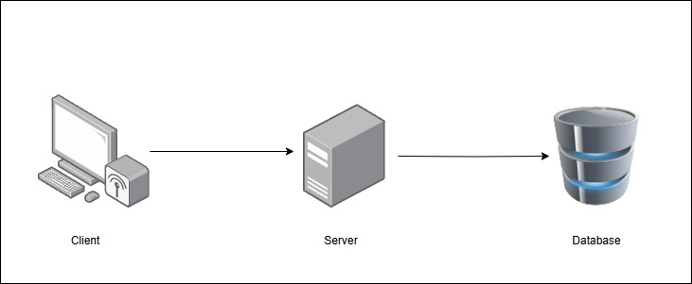
System Architecture
Figure 2: Three-Tier Architecture

Slide 17
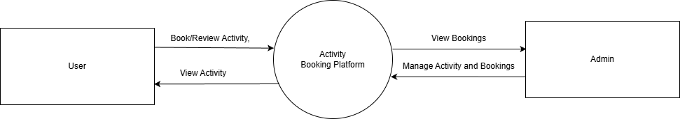
Context Diagram
Figure 3: Context Diagram for Activity Booking Platform

Slide 18
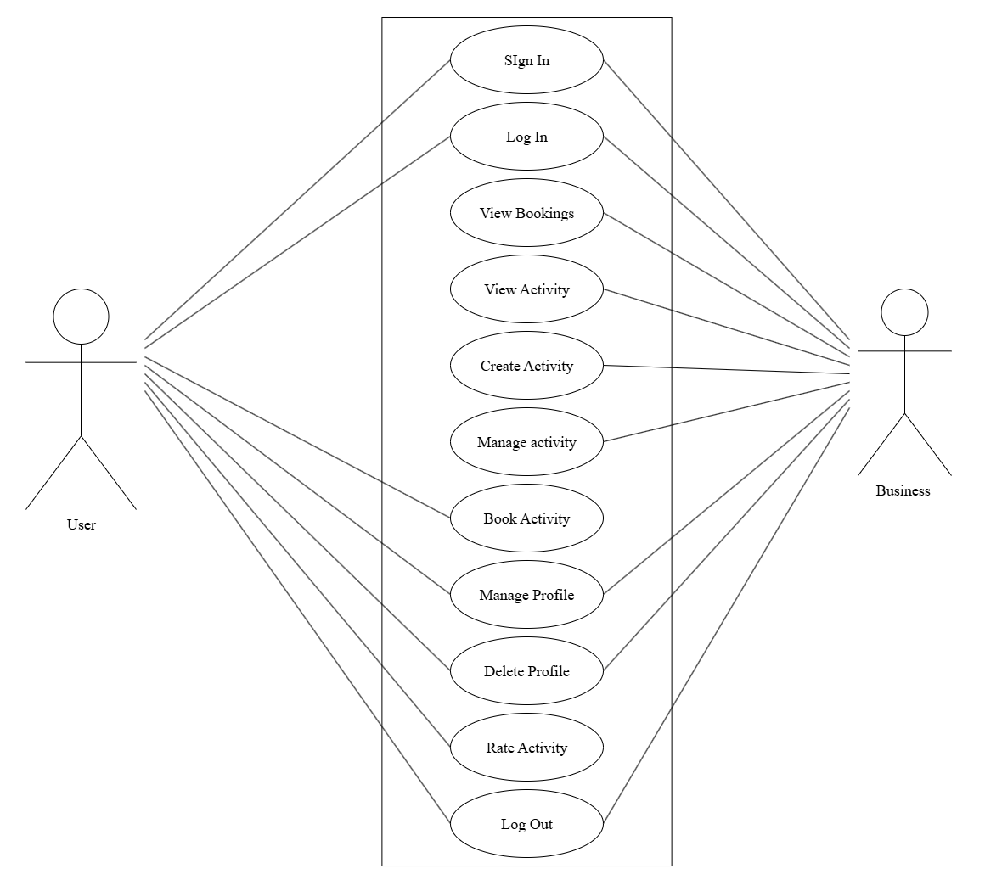
Case Diagram
Figure 4: Case Diagram for Activity Booking Platform

Slide 19
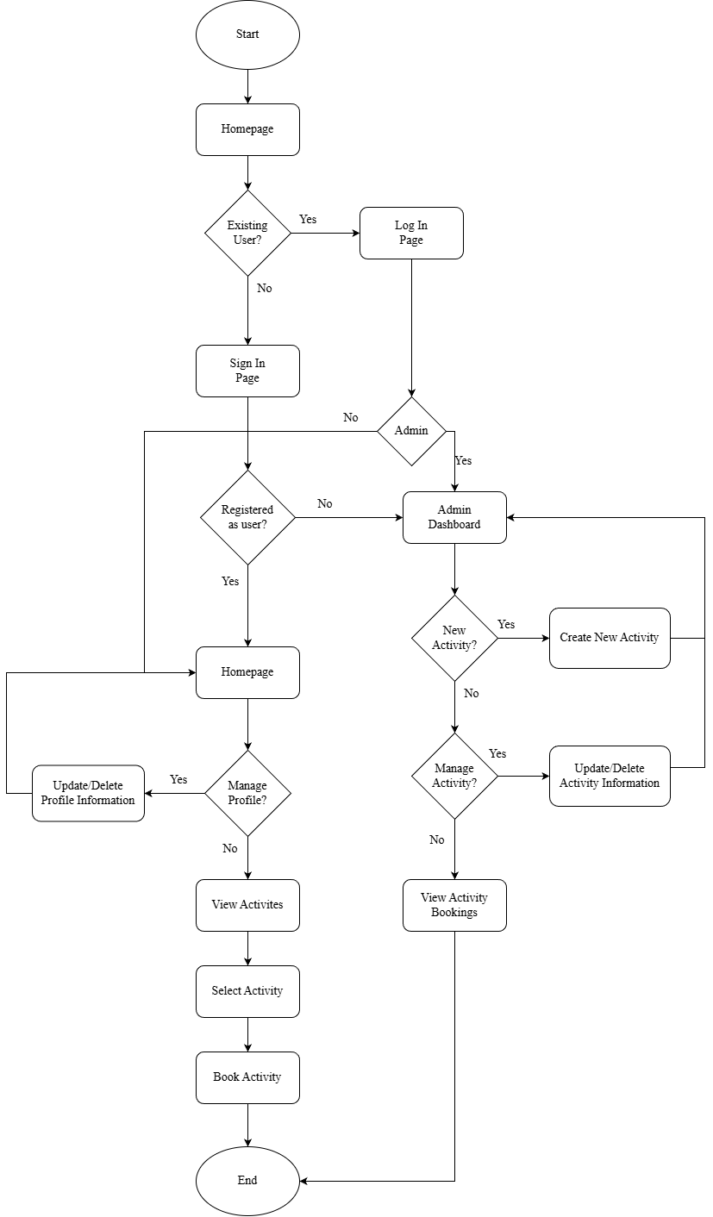
System Flow Chart
Figure 5: System Flow Chart for Activity Booking Platform

Slide 20
System Flow Chart
Figure 5: System Flow Chart for Activity Booking Platform

Slide 21
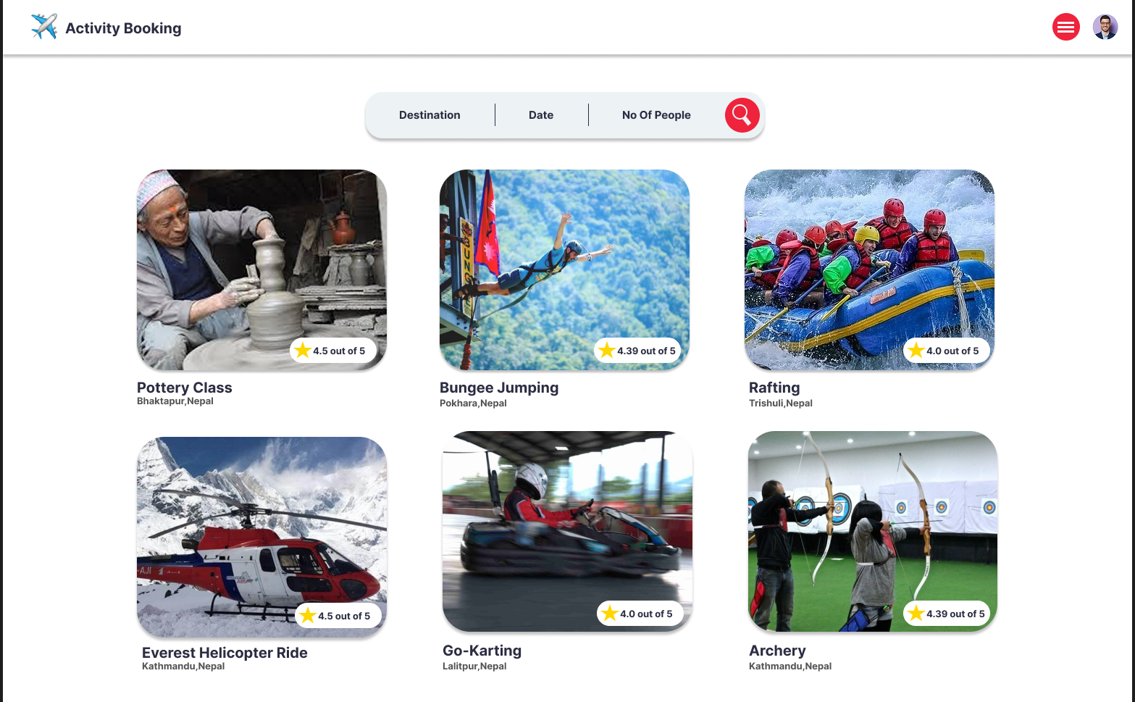
Interface Design
Figure 5: Home Page of Activity Booking Platform

Slide 22
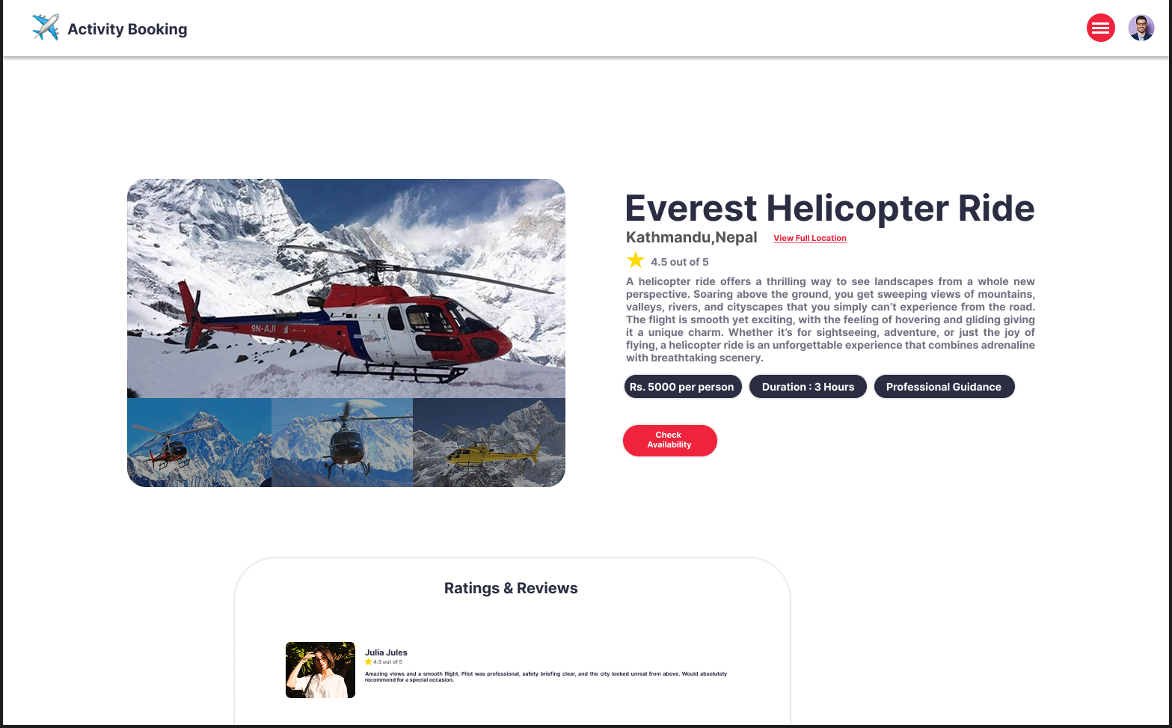
Interface Design
Figure 5: Activity Page of Activity Booking Platform

Slide 23
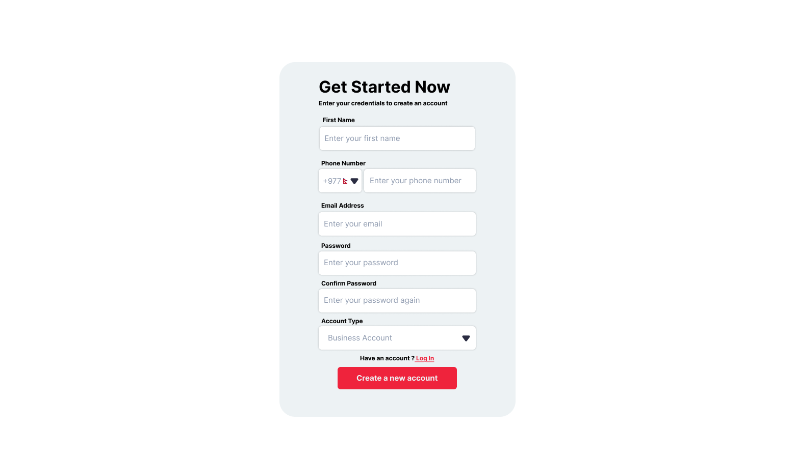
Interface Design
Figure 5: Sign In of Activity Booking Platform

Slide 24
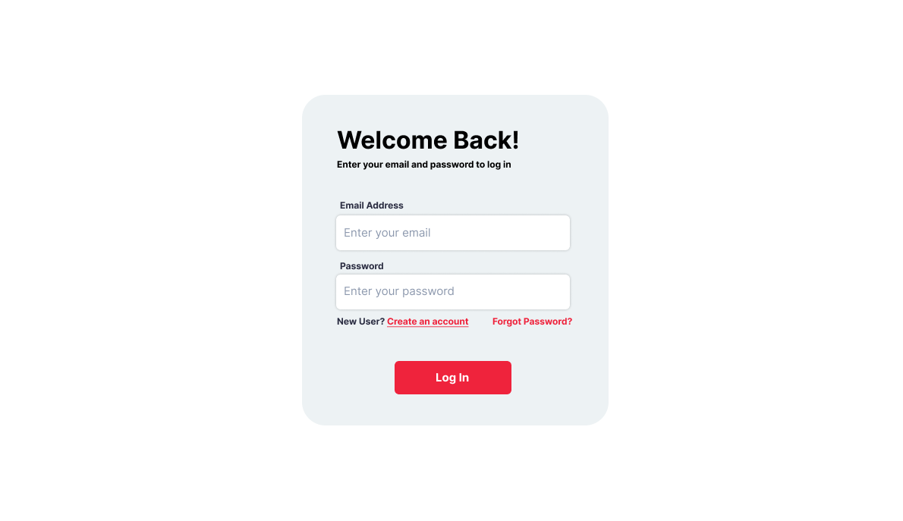
Interface Design
Figure 5: LogIn Page of Activity Booking Platform

Slide 25
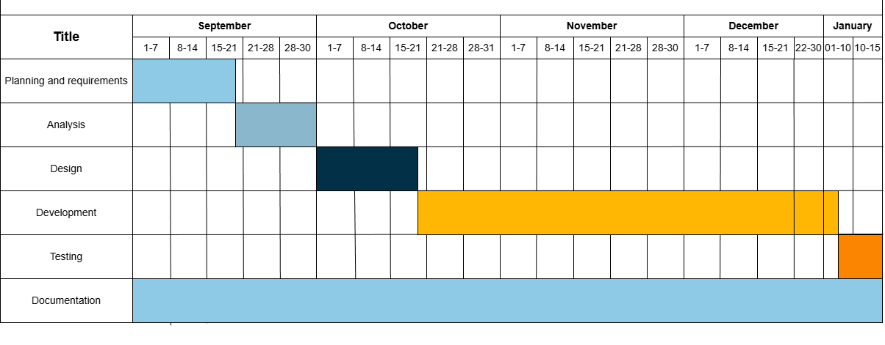
Gantt Chart
Figure 6: Gantt Chart for Activity Booking Platform

Slide 26
Tasks Completed
As of this mid-defense stage, we have successfully established the foundational core of the application. We have completed the User Registration and Authentication module to ensure secure access, alongside a functional Booking System for handling core transactions. The platform now supports Managing Activity and utilizes a Role-based System to differentiate between user and administrator permissions. Furthermore, we have integrated the ability for Adding New Ratings and a comprehensive system for Managing Profiles, ensuring that the basic user lifecycle is fully operational

Slide 27
Tasks Pending
Regarding the remaining development phase, our primary focus is the completion of several core features essential for system integrity and user management. We are currently working on implementing the profile deletion mechanism and a robust interface for editing activities to ensure data flexibility. Additionally, the final stages of the project will involve the deployment of the Admin Dashboard for centralized oversight and the User Review History Page, which will serve as a comprehensive log for user feedback and transparency."

Slide 28
Conclusion
The activities booking platform provides a centralized and user-friendly system for discovering and booking recreational activities in Nepal. It enhances local business visibility, streamlines bookings, and supports the growth of tourism and the local economy.

Slide 29
References
  [1] A. Buhalis and R. Law, “Progress in information technology and tourism management: 20 years on and 10 years after the Internet—The state of eTourism research,” Tourism Management, vol. 29, no. 4, pp. 609–623, 2008.
  [2] N. M. Maswera, R. Dawson, and J. Edwards, “E-commerce adoption of travel and tourism organisations in South Africa, Kenya, Zimbabwe and Uganda,” Telematics and Informatics, vol.25, no. 3, pp. 187–200, 2008.
  [3] Sakulsureeyadej, A. (2011). How technology is changing global tourism. In World Tourism Organization (UNWTO) Affiliate Members AM-Reports – Technology in Tourism (Vol. 1). World Tourism Organization

Slide 30
Thank You!!!

